Slide 1
Condo Design Principles & Elements of Design Related to interior design
Meirav Goldhour
Professor & Program Coordinator of Interior Design at Converse University

Slide 2
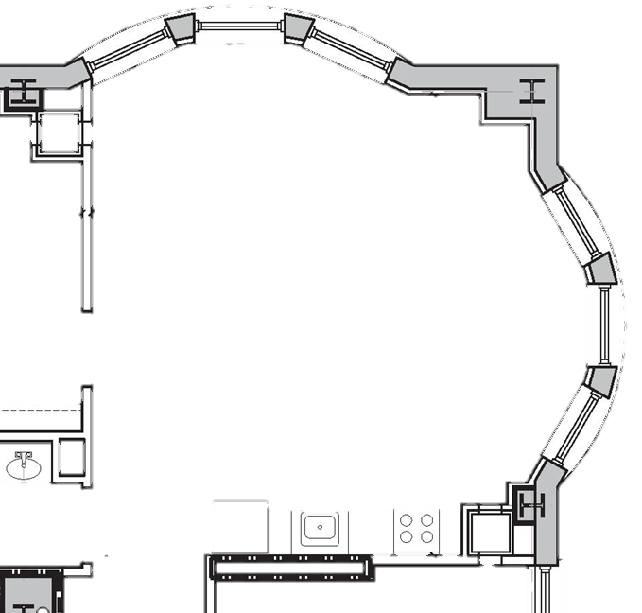
Move and rotate the furniture to design your condo! The furniture is already scaled for you!
Lounge Chairs
Sofa
OR
Square Side Tables
Round Side Tables
OR
Square Dining Set
Round Dining Set
OR

Slide 3
MATERIALS BOARD OF YOUR FINISHES AND FURNITURE SELECTION

Slide 4
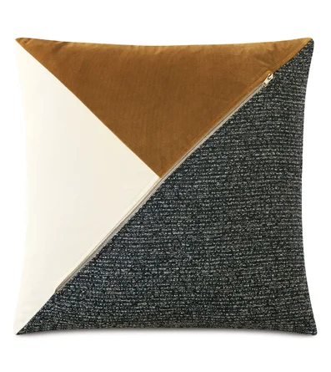
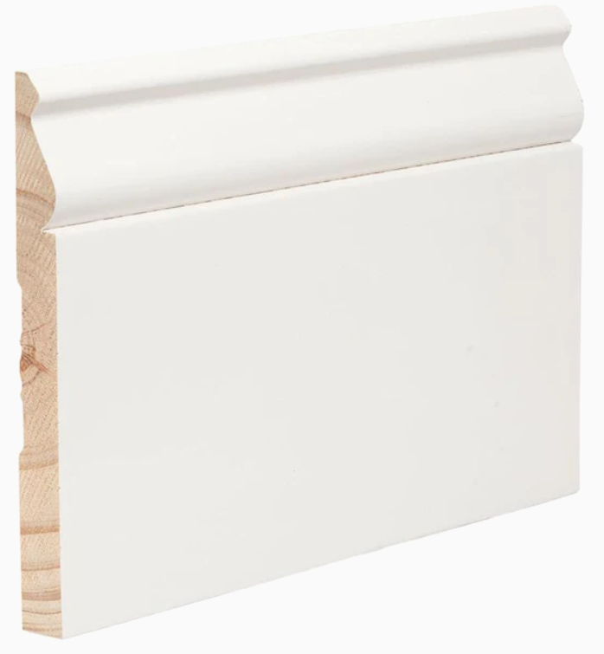
Choose ONE finish, decorative item, or piece of furniture from each category.
PAINT COLOR
THROW PILLOWS
BASEBOARD TRIM
COUNTERTOP
KITCHEN CABIENT
CABINET COLOR
SW IVORY LACE
SW HIGH REFLECTIVE WHITE
SW SPARE WHITE
SW OLYMPUS WHITE
SW MORNING AT SEA
SW DIGNITY BLUE
SW EVERGREEN FOG
GOLDEN BROWN 121 STAIN

Slide 5
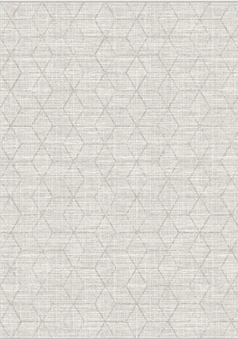
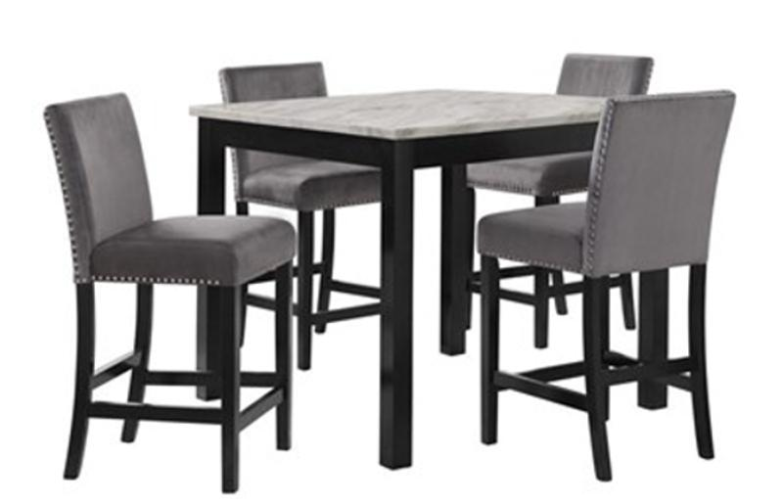
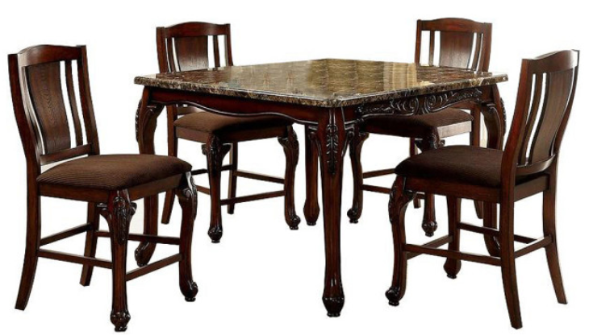
Choose ONE finish, decorative item, or piece of furniture from each category.
WALL ART
AREA RUG
SOFA
LOUNGE CHAIR
SOFA & CHAIR FABRIC
DINING SET

Slide 6
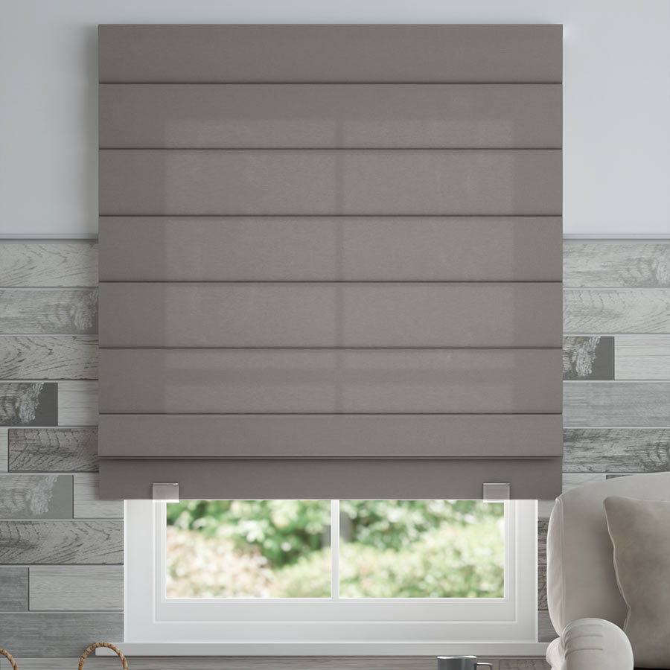
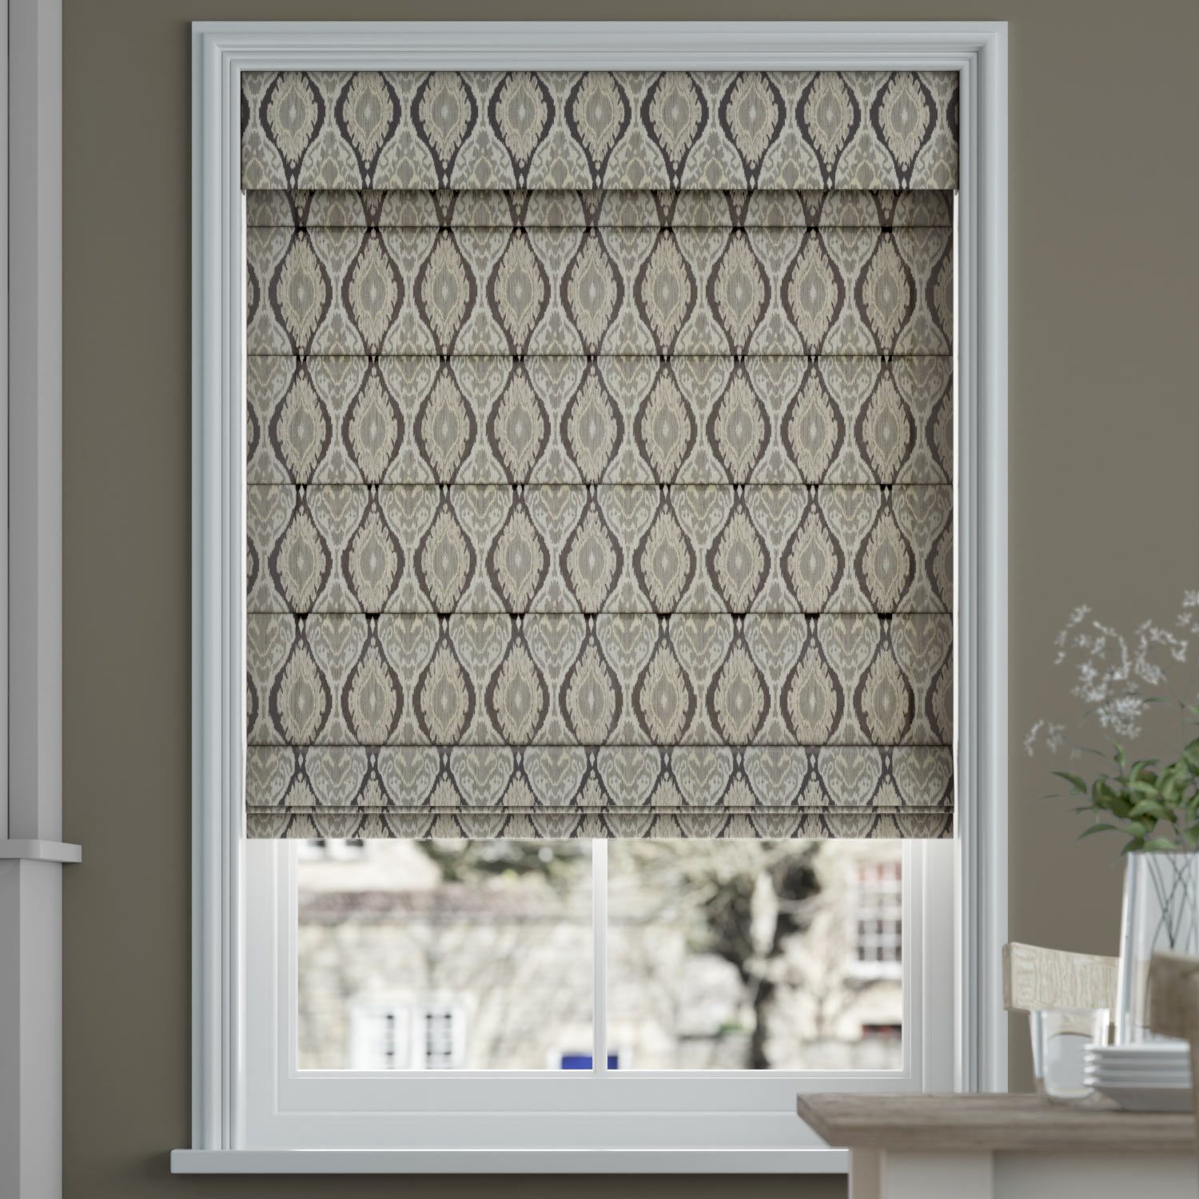
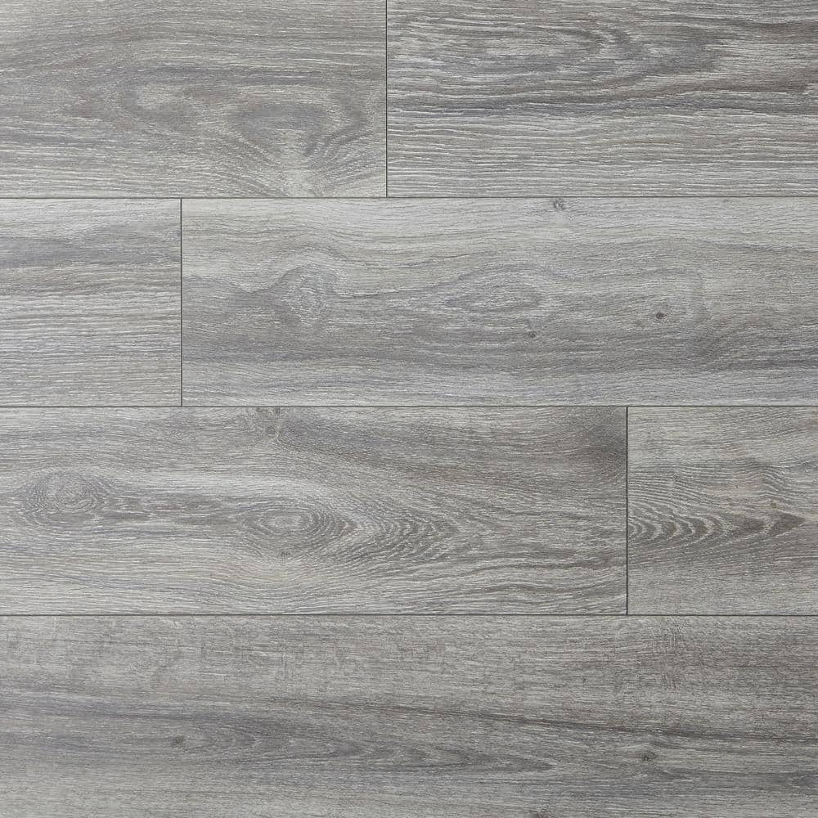
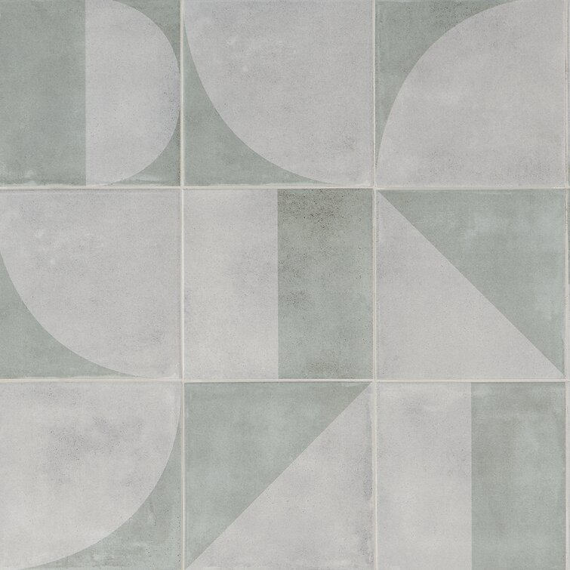
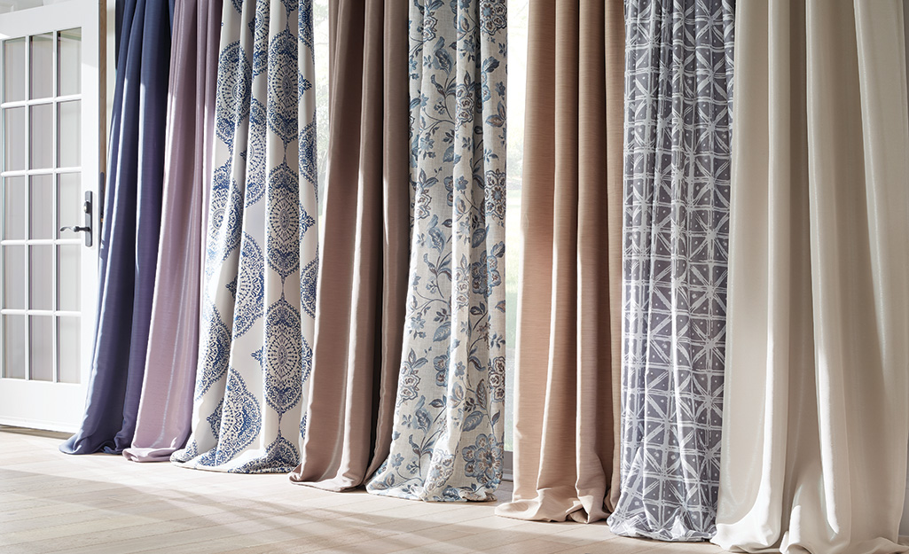
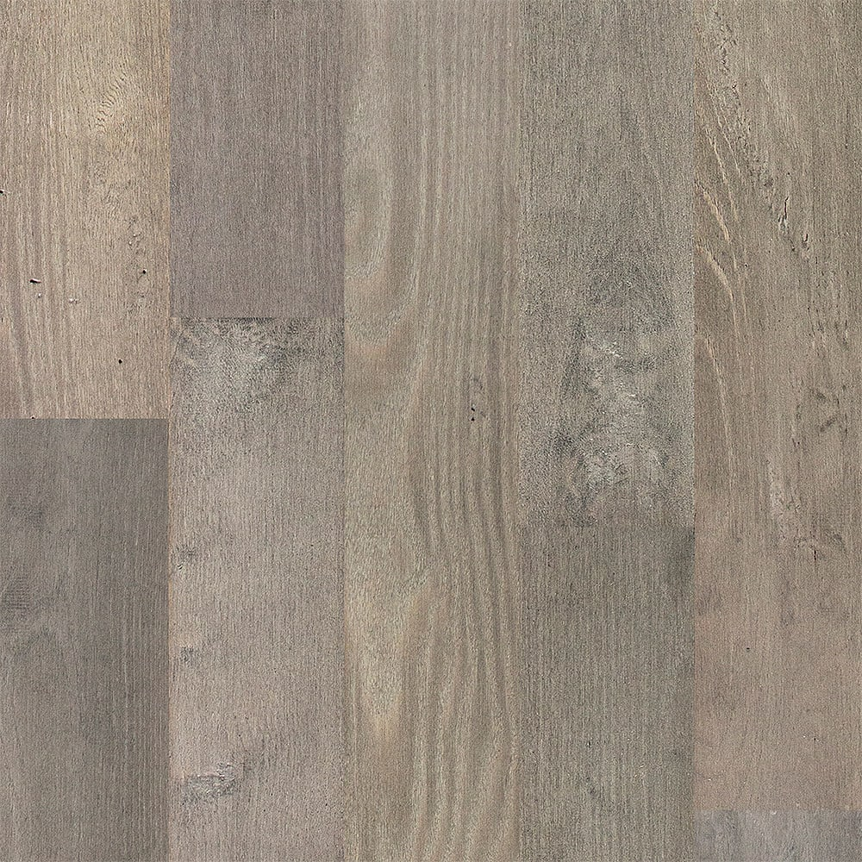
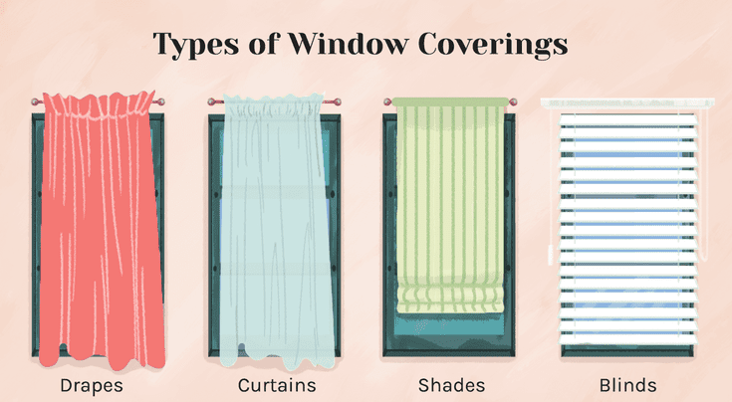
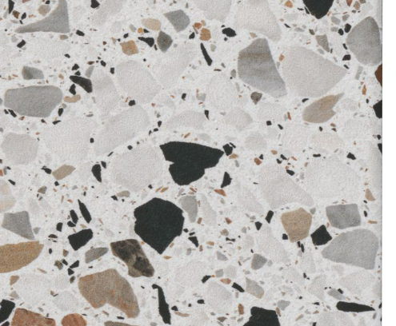
FLOORING/ WOOD
TILE
WINDOW TREATMENT

